Slide 1
Bio-medical waste
Satish Sinha
Toxics Link

Slide 2
Data On BMW India
Number of HCF 238259
Bedded Facility 87281
Number of beds 20,94,858
Number of CBWTF 198
Daily MBW generation 559 tonnes
States not having CBWTF 7
Growth rate 7%

Slide 3
Facts on coronavirus
Highly infectious
Human to human transmission
Transmission from infected surfaces
Differing Lifespan of various surfaces
Thermal and chemical disinfection
Virus destroyed at 70 Celsius for five minutes

Slide 4
Regulatory Framework/Treatment technology
Bio Medical waste management Rules 1998, revised 2016
Guidelines on COVID waste issued by CPCB
  Treatment option Incineration /Autoclave
  Current preference Incineration ?
  Double bag
  Use of PPE by waste workers

Slide 6
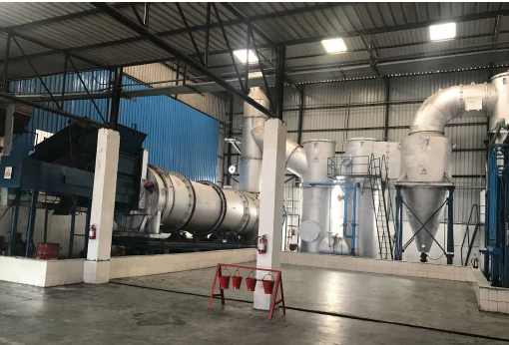

Slide 8
Challenges in managing COVID waste
Inadequate information
Increase in generation points, HH
Increase in waste generation, PPEs( Plastics)
Absence of Bio waste management systems in many states
Collection and treatment Infrastructure of HH waste
Role and capacity of ULBs ?
Overwhelm capacity

Slide 9
Road Ahead
Lack of credible data on health care waste
Improve Environmental Governance
Management of liquid waste
Possibility of Increased investment in public health
Increase in waste generation, Increase demand
Well defined and established business model
Immense opportunity for innovation and technology
Deficiency of infrastructure in select states

Slide 10
